Slide 1
Unsupervised Learning
Hung-yi Lee
Notes:
Question:
Can we use RELU auto encoder?
RBM is sigmoid, so not ReLU???
RBM CD is hard to understand
DBN is even hard, should I say more
Maybe yes:
Should I mention clustering as starting
Should I mention Sparse coding
Maybe not:
Should I mention wake and sleep algorithm?

Slide 2
Introduction
We already learn some machine learning techniques.
With labelled data, you can do any thing (hopefully).
Labelling data is expensive.
What can we do if there is no sufficient training data?
Unsupervised Learning Approaches
Restricted Boltzmann Machine (RBM)
Auto-encoder
Notes:
Exploiting unlabeled data

Slide 3
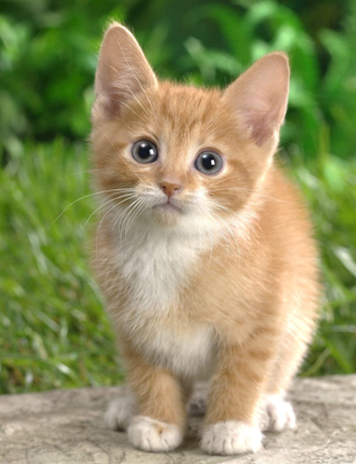
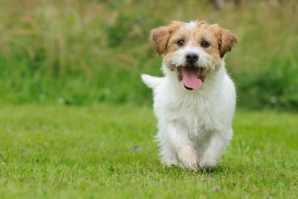
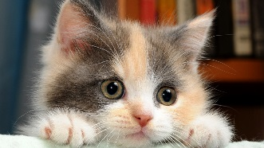
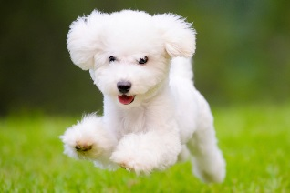
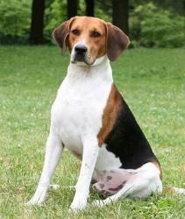

Semi-supervised Learning
Labelled data
cat
dog
Unlabeled data
(Image of cats and dogs without labeling)

Slide 4
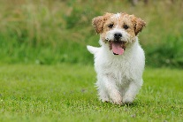
Semi-supervised Learning
Why semi-supervised learning helps?
The distribution of the unlabeled data tell us something.
Notes:
Peesuod-labels

Slide 5
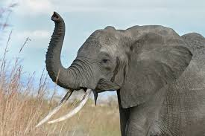
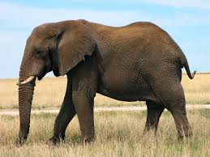
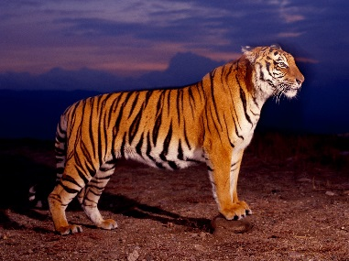
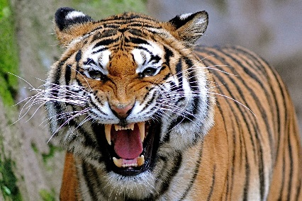
Transfer Learning
Labelled data
cat
dog
Labeled data
elephant
elephant
tiger
tiger
Not related to the task considered

Slide 6

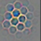




Transfer Learning
Widely used on image processing
Using sufficient labeled data to learn a CNN
Using this CNN as feature extractor
Pixels
Layer 1
Layer 2
Layer L
……
……
……
elephant
……
……
……
……
……
……

Slide 7

Transfer Learning
Example in real life
研究生 online
漫畫家 on-line
研究生
漫畫家
指導教授
責編
研究生
生存守則
跑實驗
畫分鏡
投稿期刊
投稿 jump
爆漫王
Notes:
what to say
problem
even sick
手速
進度報告

Slide 8
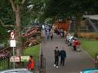
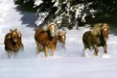
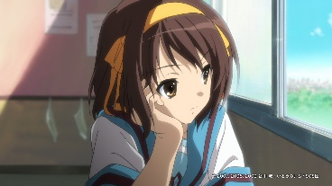

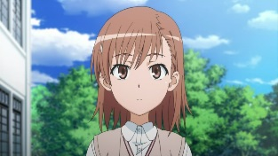
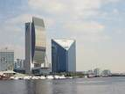
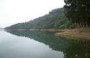
Self-taught Learning
Transfer learning with unlabeled data is not related to the task.
Labelled data
cat
dog
Unlabeled data
(Just crawl millions of images from the Internet)

Slide 9
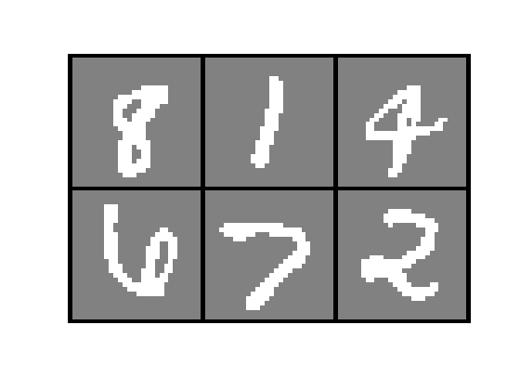
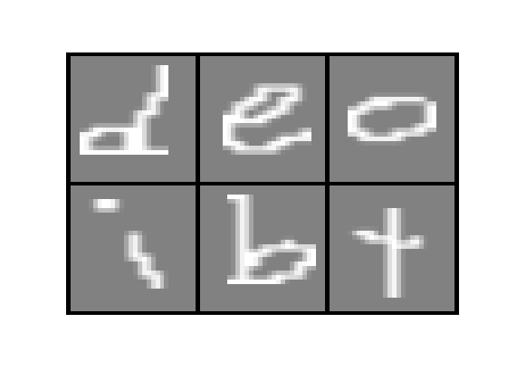



Self-taught Learning
Sometimes unlabeled data is not related to the task.
Labelled data
Unlabeled data
Digit Recognition
Digits
character
Document
Classification
Webpages
News
Speech
Recognition
English
Chinese
Taiwanese
……
Notes:
Transfer
Self-taught

Slide 10
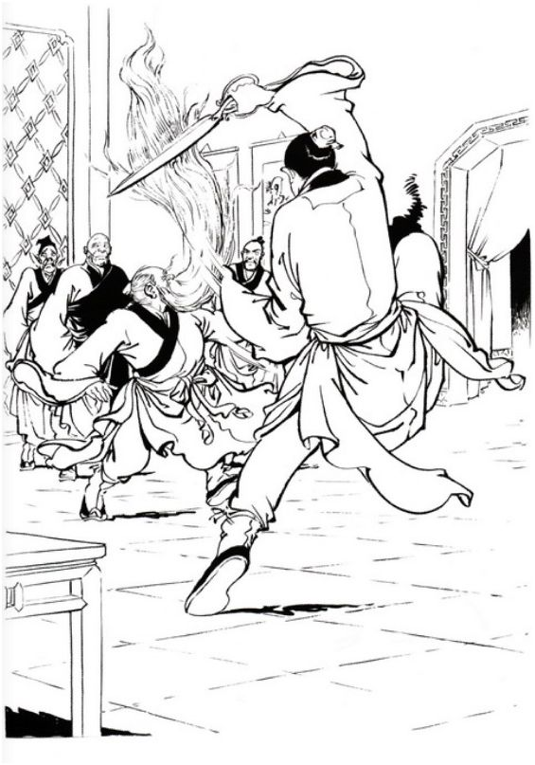
Why self-taught learning can work?
Why Unlabeled and unrelated data can help?
Find the latent factors controlling the observation
observation
Latent factor

Slide 11
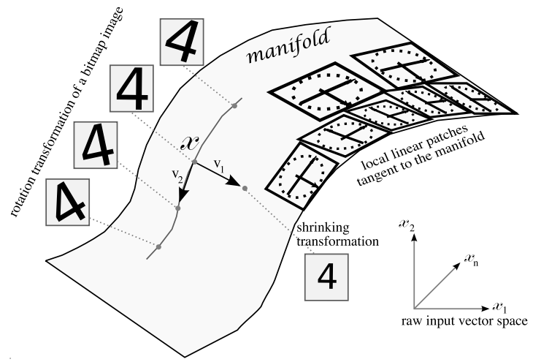
Latent Factors
Handwritten Digits

Slide 12
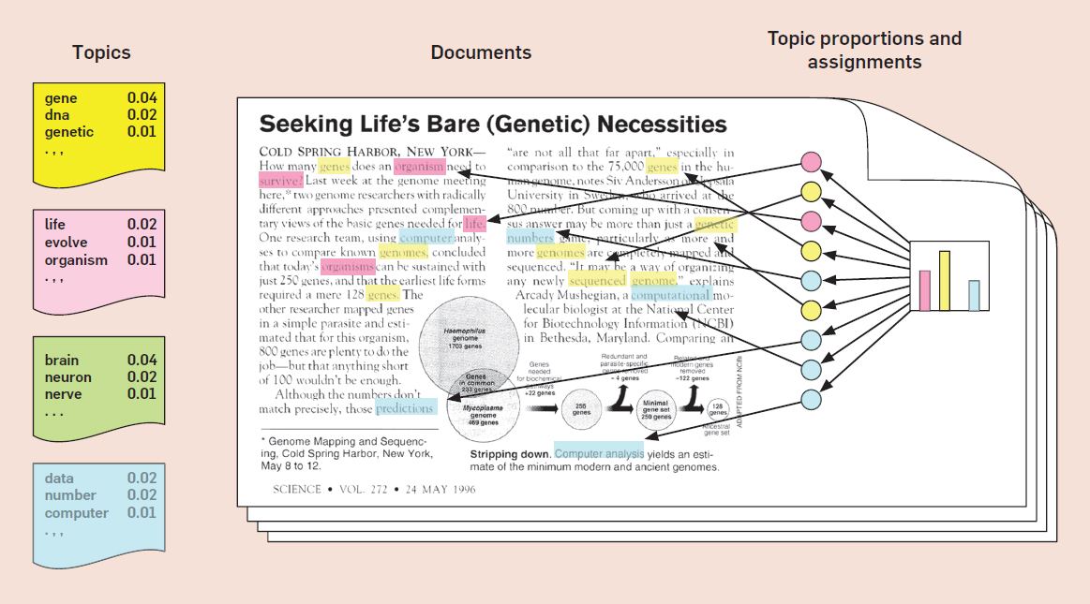
Latent Factors
Documents
http://deliveryimages.acm.org/10.1145/2140000/2133826/figs/f1.jpg
Notes:
LSA, PLSA, LDA ……

Slide 13
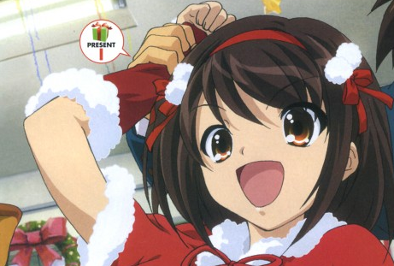
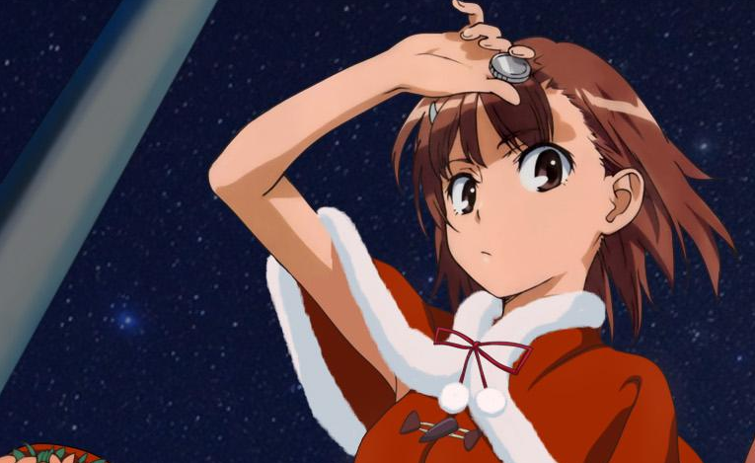
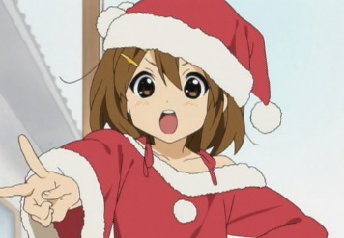



Recommendation System
萌傲嬌
A
萌天然呆
B
C
Notes:
The world we observed.
(Some combination is rare)
平澤唯

Slide 14

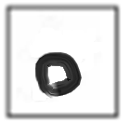



How to exploit latent factors
Handwritten Digits
The hand written images are composed of strokes.
Strokes (Latent Factors)
…….
No. 1
No. 2
No. 3
No. 4
No. 5
Notes:
Basis: linear independent, so it is not
Alien ……

Slide 15
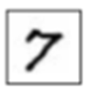
How to exploit latent factors
Strokes (Latent Factors)
…….
No. 1
No. 2
No. 3
No. 4
No. 5
28
No. 1
No. 3
No. 5
28
=
+
+
Represented by
28 X 28 = 784 pixels
[1 0 1 0 1 0 …….]
(simpler representation)
Notes:
Basis ……

Slide 16
Restricted Boltzmann Machine (RBM)
Notes:
This is structured learning
Opening: what are we goint to do ……
Inference
Training
Example
Others?
Outline:
1. introduce model
2. Motivation for training – some results and so on
3. how to train
4. some intuition – free and the figure
5. CD persist and other

Slide 17
Where are we?
Restricted Boltzmann Machine
Boltzmann Machine
Undirected Graph
(MRF, factor graph, etc.)
Graphical Model
Structured Learning

Slide 18
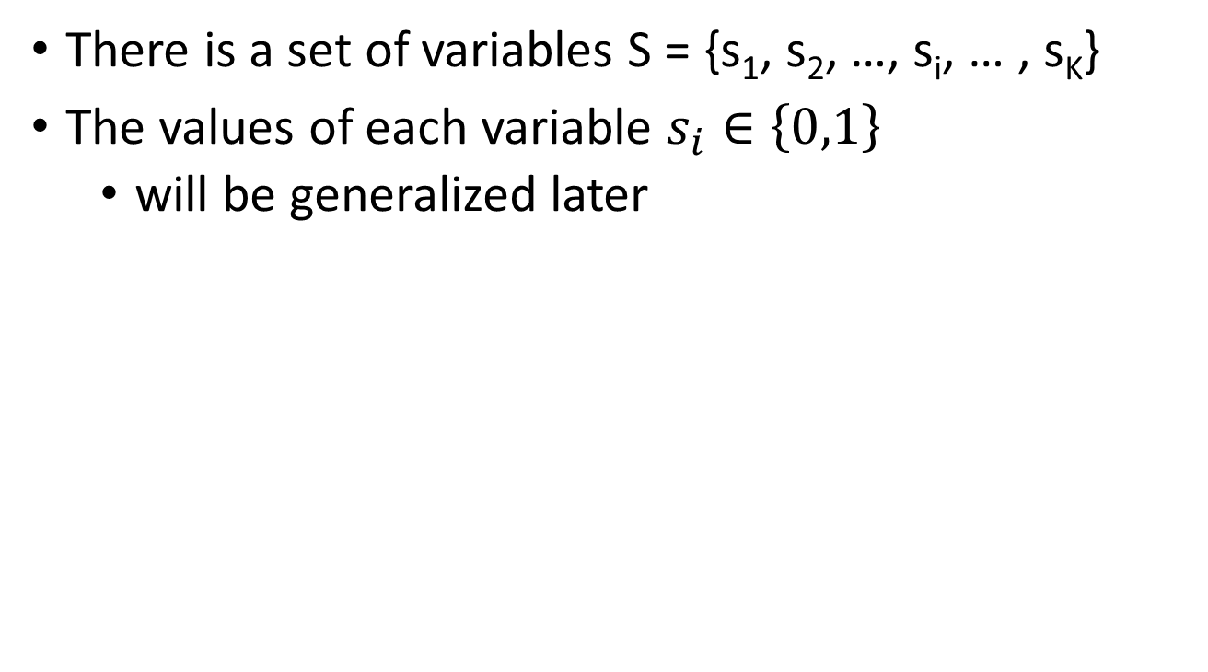
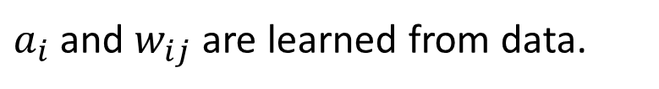
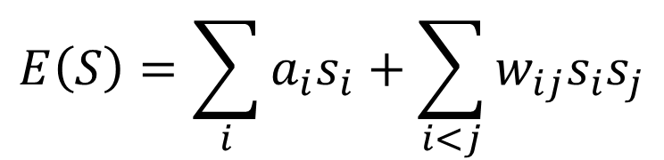
Boltzmann Machine
There is a set of variables S = {s₁, s₂, …, s_{i}, … , s_{K}}
The values of each variable $s_{i}∈\left\{0,1\right\}$
will be generalized later
Evaluation function
$$E\left(S\right)=\sum_{i}{a_{i}s_{i}}+\sum_{i<j}{w_{ij}s_{i}s_{j}}$$
When $s_{i}=1$, the evaluation function gains $a_{i}$
When $s_{i}=1$ and $s_{j}=1$, the evaluation function gains $w_{ij}$
$a_{i}$ and $w_{ij}$ are learned from data.
Notes:
Energy function would be negative

Slide 19
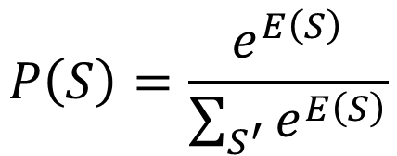
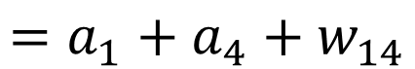
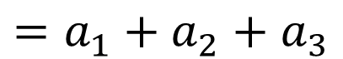
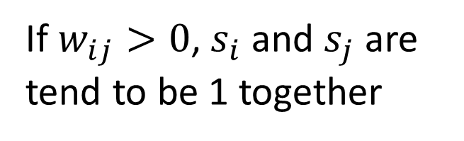
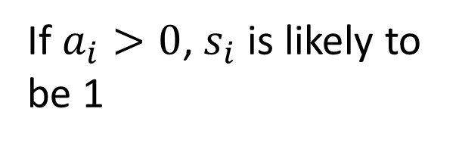
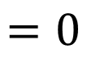
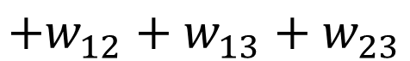
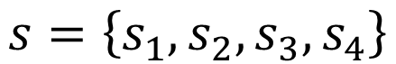
Boltzmann Machine - Example
$$s=\left\{s_{1},s_{2},s_{3},s_{4}\right\}$$
$$E\left(s_{1}=1,s_{2}=0,s_{3}=0,s_{4}=1\right)$$
$$=a_{1}+a_{4}+w_{14}$$
$$E\left(s_{1}=0,s_{2}=0,s_{3}=0,s_{4}=0\right)$$
$$=0$$
$$E\left(s_{1}=1,s_{2}=1,s_{3}=1,s_{4}=0\right)$$
$$=a_{1}+a_{2}+a_{3}$$
$$+w_{12}+w_{13}+w_{23}$$
If $a_{i}>0$, $s_{i}$ is likely to be 1
Probability Point of View
$$P\left(S\right)=\frac{e^{E\left(S\right)}}{\sum_{S^{′}}{e^{E\left(S\right)}}}$$
If $w_{ij}>0$, $s_{i}$ and $s_{j}$ are tend to be 1 together

Slide 20
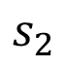
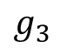
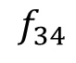
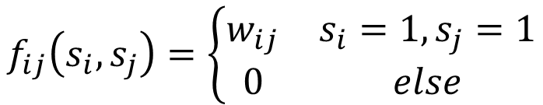
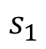
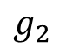
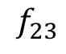
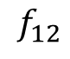
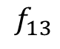
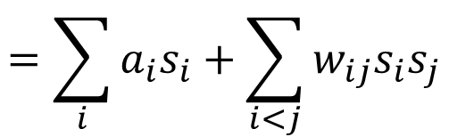
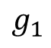
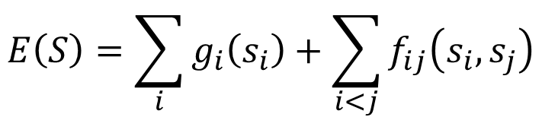






Boltzmann Machine - Factor Graph
There are factors for each node and factors between each node pair
$$g_{2}$$
$$g_{3}$$
Factor for a node:
$$f_{23}$$
$$s_{2}$$
$$s_{3}$$
$$g_{i}\left(s_{i}\right)=\left\{\begin{matrix}a_{i} & s_{i}=1 \\ 0 & else\end{matrix}\right.$$
$$f_{24}$$
$$f_{12}$$
$$f_{13}$$
$$f_{34}$$
Factor between nodes:
$$s_{1}$$
$$s_{4}$$
$$f_{ij}\left(s_{i},s_{j}\right)=\left\{\begin{matrix}w_{ij} & s_{i}=1,s_{j}=1 \\ 0 & else\end{matrix}\right.$$
$$f_{14}$$
$$g_{1}$$
$$g_{4}$$
$$E\left(S\right)=\sum_{i}{g_{i}\left(s_{i}\right)}+\sum_{i<j}{f_{ij}\left(s_{i},s_{j}\right)}$$
$$=\sum_{i}{a_{i}s_{i}}+\sum_{i<j}{w_{ij}s_{i}s_{j}}$$
Notes:
The factors are simpler than normal factor graph or MRF

Slide 21








Restricted Boltzmann Machine (RBM)
The variables are separated into two sets
The variables in the same sets are not connected
$$E\left(x,h\right)=\sum_{h_{i}}{b_{i}h_{i}}$$
Latent
Factor
$$h_{1}$$
$$h_{2}$$
$$+\sum_{x_{j}}{c_{j}x_{j}}$$
$$x_{1}$$
$$x_{2}$$
$$x_{3}$$
$$+\sum_{h_{i},x_{j}}{w_{ij}h_{i}x_{j}}$$
What we can observed.
Notes:
Maximum or minimum

Slide 22

RBM – Example
萌傲嬌?
萌天然呆?
High probability
某宅的內心世界
1
1
-1
1
-1
-1
1
-1

Slide 23
RBM – Example
萌傲嬌?
萌天然呆?
Low probability
某宅的內心世界
1
1
-1
1
-1
-1
1
-1
Notes:
Not explainalbe

Slide 24





RBM - Inference
Given the parameters, compute $P\left(h_{j}=1|x\right)$ is simple
$$h_{j}$$
Given x, all $h_{j}$ are independent
Given h, all $x_{i}$ are independent
$$x_{j}$$
(see the reference)
Notes:
Neural networks [5.2] : Restricted Boltzmann machine - inference
https://www.youtube.com/watch?v=lekCh_i32iE&list=PL6Xpj9I5qXYEcOhn7TqghAJ6NAPrNmUBH&index=36
In undirected graphical model, normalize as probability is usually difficult.
All the y are independent
Just test 1 or 0 will make the value larger.?

Slide 25












RBM
$$E\left(x,h\right)=\sum_{h_{i}}{b_{i}h_{i}}$$
$$+\sum_{x_{j}}{c_{j}x_{j}}$$
$$+\sum_{h_{i},x_{j}}{w_{ij}h_{i}x_{j}}$$
Given the parameters, compute $P\left(h_{j}=1|x\right)$ is simple
$$P\left(x,h\right)=\frac{e^{E\left(x,h\right)}}{\sum_{x^{′},h^{′}}{e^{E\left(x^{′},h^{′}\right)}}}$$
$$P\left(h_{i}=1|x\right)$$
$$=P\left(h_{i}=1|x,h_{−i}\right)$$
$$=\frac{P\left(x,h_{−i},h_{i}=1\right)}{P\left(x,h_{−i},h_{i}=1\right)+P\left(x,h_{−i},h_{i}=0\right)}$$
$$=\frac{e^{E\left(x,h_{−i},h_{i}=1\right)}}{e^{E\left(x,h_{−i},h_{i}=1\right)}+e^{E\left(x,h_{−i},h_{i}=0\right)}}$$
Only the terms related to $h_{i}$ are different
$$=\frac{e^{b_{i}+\sum_{x_{j}}{w_{ij}x_{j}}}}{e^{b_{i}+\sum_{x_{j}}{w_{ij}x_{j}}}+1}$$
$$=\frac{1}{{1+e}^{−\left(b_{i}+\sum_{x_{j}}{w_{ij}x_{j}}\right)}}$$
$$=sig\left(b_{i}+\sum_{,x_{j}}{w_{ij}x_{j}}\right)$$

Slide 26













RBM - Inference
Given the parameters, compute $P\left(h_{j}=1|x\right)$ is simple
Given x₁, x₂ and x₃
$$h_{1}$$
$$h_{2}$$
$$P\left(h_{1}=1|x\right)$$
$$=σ\left(b_{1}+w_{11}x_{1}+w_{12}x_{2}+w_{13}x_{3}\right)$$
$$w_{11}$$
$$w_{23}$$
$$P\left(h_{2}=1|x\right)$$
$$w_{21}$$
$$w_{12}$$
$$w_{22}$$
$$w_{13}$$
$$=σ\left(b_{2}+w_{21}x_{1}+w_{22}x_{2}+w_{23}x_{3}\right)$$
$$x_{1}$$
$$x_{2}$$
$$x_{3}$$
Given h₁, h₂ ……
(誤)
Neural network with sigmoid function as activation function
Notes:
Maximum or minimum

Slide 27





$P$(萌傲嬌=1|x) = $\frac{1}{1+exp\left(−2\right)}$
$P$(萌天然呆=1|x) = $\frac{1}{1+exp\left(2\right)}$
萌傲嬌?
萌天然呆?
宅的內心世界
1
1
-1
1
-1
-1
1
-1
1
1
0
0

Slide 28






RBM – Training without Labeling?
$$x^{1}$$
$$x^{2}$$
$$x^{3}$$
Training data: $\left\{x^{1},x^{2}⋯x^{R}\right\}$
Find the parameters which
Maximizing the likelihood of observed data
$$\prod_{r=1}^{R}{P\left(x^{r}\right)}$$
maximize

Slide 29






RBM – Training without Labeling?
Maximizing P(x)
$$P\left(x\right)=\sum_{h^{′′}}{P\left(x,h^{′′}\right)}$$
$$=\sum_{h^{′′}}{\frac{e^{E\left(x,h^{′′}\right)}}{\sum_{x^{′},h^{′}}{e^{E\left(x^{′},h^{′}\right)}}}}$$
$$=\frac{\sum_{h^{′′}}{e^{E\left(x,h^{′′}\right)}}}{\sum_{x^{′}}{\sum_{h^{′}}{e^{E\left(x^{′},h^{′}\right)}}}}$$
$$F\left(x\right)=\sum_{h^{′′}}{e^{E\left(x,h^{′′}\right)}}$$
$$P\left(x\right)=\frac{F\left(x\right)}{\sum_{x^{′}}{F\left(x^{′}\right)}}$$
$$F\left(x\right)=exp\left(\sum_{x_{j}}{c_{j}x_{j}+\sum_{h_{i}}{log\left(1+exp\left(b_{i}+\sum_{x_{j}}{w_{ij}x_{j}}\right)\right)}}\right)$$
(see the reference)
Notes:
Neural networks [5.3] : Restricted Boltzmann machine - free energy
https://www.youtube.com/watch?v=e0Ts_7Y6hZU&index=38&list=PL6Xpj9I5qXYEcOhn7TqghAJ6NAPrNmUBH

Slide 30



RBM – Training without Labeling?
$$F\left(x\right)=exp\left(\sum_{x_{j}}{c_{j}x_{j}+\sum_{h_{i}}{log\left(1+exp\left(b_{i}+\sum_{x_{j}}{w_{ij}x_{j}}\right)\right)}}\right)$$
$$=exp\left(\sum_{x_{j}}{c_{j}x_{j}+\sum_{h_{i}}{softplus\left(b_{i}+\sum_{x_{j}}{w_{ij}x_{j}}\right)}}\right)$$
SoftPlus
ReLU

Slide 31















RBM – Training without Labeling?
$$a_{1}$$
$$a_{2}$$
Neural network with Softplus as activation function
(誤)
$$h_{1}$$
$$h_{2}$$
$$F\left(x\right)=exp\left(a_{1}+a_{2}\right)$$
$$w_{11}$$
$$w_{23}$$
The degree that the hidden layers are activated.
$$w_{21}$$
$$w_{12}$$
$$w_{22}$$
$$w_{13}$$
$$x_{1}$$
$$x_{2}$$
$$x_{3}$$
$$P\left(x\right)=\frac{F\left(x\right)}{\sum_{x^{′}}{F\left(x^{′}\right)}}$$
Increase for x in data
Decrease for any x
Notes:
Learn to ignore
集中的效果

Slide 32











RBM – Training by Gradient Ascent
Given data $\left\{x^{1},x^{2}⋯x^{R}\right\}$
$$\prod_{r=1}^{R}{P\left(x^{r}\right)}$$
$$\sum_{r=1}^{R}{logP\left(x^{r}\right)}$$
maximize
maximize
$$P\left(x\right)=\sum_{h^{′′}}{P\left(x,h^{′′}\right)}$$
$$=\sum_{h^{′′}}{\frac{e^{E\left(x,h^{′′}\right)}}{\sum_{x^{′},h^{′}}{e^{E\left(x^{′},h^{′}\right)}}}}$$
$$=\frac{\sum_{h^{′′}}{e^{E\left(x,h^{′′}\right)}}}{\sum_{x^{′},h^{′}}{e^{E\left(x^{′},h^{′}\right)}}}$$
$$logP\left(x\right)=log\sum_{h^{′′}}{e^{E\left(x,h^{′′}\right)}}−log\sum_{x^{′},h^{′}}{e^{E\left(x^{′},h^{′}\right)}}$$
$$w_{ij}←w_{ij}+η\frac{∂logP\left(x\right)}{∂w_{ij}}$$
$$\frac{∂logP\left(x\right)}{∂w_{ij}}=?$$
compute
Notes:
Max margin
http://ijcai.org/papers09/Papers/IJCAI09-195.pdf

Slide 33
Warning of Math

Slide 34













$$logP\left(x\right)=log\sum_{h^{′′}}{e^{E\left(x,h^{′′}\right)}}−log\sum_{x^{′},h^{′}}{e^{E\left(x^{′},h^{′}\right)}}$$
$$\frac{∂logP\left(x\right)}{∂w_{ij}}=?$$
A
B
$$E\left(x,h\right)=\sum_{h_{i}}{b_{i}h_{i}}$$
$$+\sum_{x_{j}}{c_{j}x_{j}}$$
$$+\sum_{h_{i},x_{j}}{w_{ij}h_{i}x_{j}}$$
$$\frac{∂E\left(x,h\right)}{∂w_{ij}}=h_{i}x_{j}$$
$$\frac{∂A}{∂w_{ij}}$$
$$=\frac{1}{\sum_{h^{′′}}{e^{E\left(x,h^{′′}\right)}}}\sum_{h^{′′}}{\frac{∂e^{E\left(x,h^{′′}\right)}}{∂w_{ij}}}$$
$$=\frac{1}{\sum_{h^{′′}}{e^{E\left(x,h^{′′}\right)}}}\sum_{h^{′′}}{e^{E\left(x,h^{′′}\right)}\frac{∂E\left(x,h^{′′}\right)}{∂w_{ij}}}$$
$$=\frac{1}{\sum_{h^{′′}}{e^{E\left(x,h^{′′}\right)}}}\sum_{h^{′′}}{e^{E\left(x,h^{′′}\right)}h_{i}^{′′}x_{j}}$$
$$=\sum_{h^{′′}}{\frac{e^{E\left(x,h^{′′}\right)}}{\sum_{h^{′′}}{e^{E\left(x,h^{′′}\right)}}}h_{i}^{′′}x_{j}}$$
$$=\sum_{h^{′′}}{P\left(h^{′′}|x\right)h_{i}^{′′}x_{j}}$$
$$P\left(h^{′′}|x\right)$$
Notes:
Not this page

Slide 35






$$logP\left(x\right)=log\sum_{h^{′′}}{e^{E\left(x,h^{′′}\right)}}−log\sum_{x^{′},h^{′}}{e^{E\left(x^{′},h^{′}\right)}}$$
$$\frac{∂logP\left(x\right)}{∂w_{ij}}=?$$
A
B
$$\frac{∂B}{∂w_{ij}}$$
$$=\frac{1}{\sum_{x^{′},h^{′}}{e^{E\left(x^{′},h^{′}\right)}}}\sum_{x^{′},h^{′}}{\frac{∂e^{E\left(x^{′},h^{′}\right)}}{∂w_{ij}}}$$
$$=\frac{1}{\sum_{x^{′},h^{′}}{e^{E\left(x^{′},h^{′}\right)}}}\sum_{x^{′},h^{′}}{e^{E\left(x^{′},h^{′}\right)}\frac{∂E\left(x^{′},h^{′}\right)}{∂w_{ij}}}$$
$$=\frac{1}{\sum_{x^{′},h^{′}}{e^{E\left(x^{′},h^{′}\right)}}}\sum_{x^{′},h^{′}}{e^{E\left(x^{′},h^{′}\right)}h_{i}^{′}x_{j}^{′}}$$
$$=\sum_{x^{′},h^{′}}{\frac{e^{E\left(x^{′},h^{′}\right)}}{\sum_{x^{′},h^{′}}{e^{E\left(x^{′},h^{′}\right)}}}h_{i}^{′}x_{j}^{′}}$$
$$=\sum_{x^{′},h^{′}}{P\left(x^{′},h^{′}\right)h_{i}^{′}x_{j}^{′}}$$
Notes:
Not this page

Slide 36
End of Warning

Slide 37




$$logP\left(x\right)=log\sum_{h^{′′}}{e^{E\left(x,h^{′′}\right)}}−log\sum_{x^{′},h^{′}}{e^{E\left(x^{′},h^{′}\right)}}$$
$$\frac{∂logP\left(x\right)}{∂w_{ij}}=?$$
A
B
$$\frac{∂A}{∂w_{ij}}$$
$$=\sum_{h^{′′}}{P\left(h^{′′}|x\right)h_{i}^{′′}x_{j}}$$
$$=E_{P\left(h^{′′}|x\right)}\left[h_{i}^{′′}x_{j}\right]$$
The expected value of $h_{i}^{′′}x_{j}$ based on $P\left(h^{′′}|x\right)$ given the current parameters

Slide 38




$$logP\left(x\right)=log\sum_{h^{′′}}{e^{E\left(x,h^{′′}\right)}}−log\sum_{x^{′},h^{′}}{e^{E\left(x^{′},h^{′}\right)}}$$
$$\frac{∂logP\left(x\right)}{∂w_{ij}}=?$$
A
B
$$\frac{∂A}{∂w_{ij}}$$
$$=\sum_{h^{′′}}{P\left(h^{′′}|x\right)h_{i}^{′′}x_{j}}$$
$$=E_{P\left(h^{′′}|x\right)}\left[h_{i}^{′′}x_{j}\right]$$
The expected value of $h_{i}^{′′}x_{j}$ based on $P\left(h^{′′}|x\right)$ given the current parameters
$$\frac{∂B}{∂w_{ij}}$$
$$=\sum_{x^{′},h^{′}}{P\left(x^{′},h^{′}\right)h_{i}^{′}x_{j}^{′}}$$
$$=E_{P\left(x^{′},h^{′}\right)}\left[h_{i}^{′}x_{j}^{′}\right]$$
The expected value of $h_{i}^{′}x_{j}^{′}$ based on $P\left(x^{′},h^{′}\right)$ given the current parameters

Slide 39






RBM – Training by Gradient Ascent
$$w_{ij}←w_{ij}+η\frac{∂logP\left(x\right)}{∂w_{ij}}$$
$$\frac{∂logP\left(x\right)}{∂w_{ij}}=E_{P\left(h^{′′}|x\right)}\left[h_{i}^{′′}x_{j}\right]−E_{P\left(x^{′},h^{′}\right)}\left[h_{i}^{′}x_{j}^{′}\right]$$
$$h_{i}$$
1
$$h_{i}$$
1
increase
decrease
$$x_{j}$$
1
$$x_{j}$$
1
Given x
Notes:
If $x_{j}$ and $h_{i}$ frequently be 1 together, then increase the weight between them.

Slide 40












$$logP\left(x\right)=log\sum_{h^{′′}}{e^{E\left(x,h^{′′}\right)}}−log\sum_{x^{′},h^{′}}{e^{E\left(x^{′},h^{′}\right)}}$$
$$\frac{∂logP\left(x\right)}{∂w_{ij}}=?$$
A
B
$$\frac{∂A}{∂w_{ij}}$$
$$=\sum_{h^{′′}}{P\left(h^{′′}|x\right)h_{i}^{′′}x_{j}}$$
$$=E_{P\left(h^{′′}|x\right)}\left[h_{i}^{′′}x_{j}\right]$$
$$=P\left(h_{i}^{′′}=1|x\right)x_{j}$$
Just a sigmoid
$$P\left(h_{i}^{′′}=1|x\right)=sig\left(b_{i}+\sum_{x_{j}}{w_{ij}x_{j}}\right)$$
$$h_{i}$$
$$x_{j}$$
Notes:
How to explain term A ……

Slide 41







$$logP\left(x\right)=log\sum_{h^{′′}}{e^{E\left(x,h^{′′}\right)}}−log\sum_{x^{′},h^{′}}{e^{E\left(x^{′},h^{′}\right)}}$$
$$\frac{∂logP\left(x\right)}{∂w_{ij}}=?$$
A
B
$$\frac{∂A}{∂w_{ij}}$$
$$=\sum_{h^{′′}}{P\left(h^{′′}|x\right)h_{i}^{′′}x_{j}}$$
$$=E_{P\left(h^{′′}|x\right)}\left[h_{i}^{′′}x_{j}\right]$$
$$=P\left(h_{i}^{′′}=1|x\right)x_{j}$$
Just a sigmoid
$$\frac{∂B}{∂w_{ij}}$$
$$=\sum_{x^{′},h^{′}}{P\left(x^{′},h^{′}\right)h_{i}^{′}x_{j}^{′}}$$
Exact computing is not tractable
$$=E_{P\left(x^{′},h^{′}\right)}\left[h_{i}^{′}x_{j}^{′}\right]$$
$$x^{1},h^{1}\sim P\left(x^{′},h^{′}\right)$$
Sample by Gibbs sampling
$$\frac{1}{N}\sum_{n=1}^{N}{h_{i}^{n}x_{j}^{n}}$$
$$x^{2},h^{2 }\sim P\left(x^{′},h^{′}\right)$$
……
$$x^{N},h^{N }\sim P\left(x^{′},h^{′}\right)$$
Notes:
Intractable …!!!!!

Slide 42


















RBM –Gibbs Sampling
Random initialize $x^{0},h^{0}$
Use Gibbs sampling to sample from P(x,h)
For n = 1 to N
$$x_{1}^{n}\sim P\left(x_{1}|x_{2}^{n−1},x_{3}^{n−1}{,h}_{1}^{n−1},h_{2}^{n−1}\right)$$
$$h_{1}$$
$$h_{2}$$
$$x_{2}^{n}\sim P\left(x_{2}|x_{1}^{n},x_{3}^{n−1}{,h}_{1}^{n−1},h_{2}^{n−1}\right)$$
$$x_{3}^{n}\sim P\left(x_{3}|x_{1}^{n},x_{2}^{n}{,h}_{1}^{n−1},h_{2}^{n−1}\right)$$
$$w_{11}$$
$$w_{23}$$
$$h_{1}^{n}\sim P\left(h_{1}|x_{1}^{n},x_{2}^{n},x_{3}^{n},h_{2}^{n−1}\right)$$
$$w_{21}$$
$$w_{12}$$
$$w_{22}$$
$$w_{13}$$
$$h_{2}^{n}\sim P\left(h_{2}|x_{1}^{n},x_{2}^{n},x_{3}^{n},{,h}_{1}^{n}\right)$$
$$x_{1}$$
$$x_{2}$$
$$x_{3}$$
Obtain one sample $x^{n},h^{n}$
( as sample from P(x,h) )

Slide 43







RBM –Gibbs Sampling
Random initialize $x^{0},h^{0}$
Use Gibbs sampling to sample from P(x,h)
For n = 1 to N
$$x_{1}^{n}\sim P\left(x_{1}|h_{1}^{n−1},h_{2}^{n−1}\right)$$
$$h_{1}$$
$$h_{2}$$
$$x_{2}^{n}\sim P\left(x_{2}| h_{1}^{n−1},h_{2}^{n−1}\right)$$
$$x_{3}^{n}\sim P\left(x_{3}|h_{1}^{n−1},h_{2}^{n−1}\right)$$
$$x^{n}\sim P\left(x|h_{}^{n−1}\right)$$
$$w_{11}$$
$$w_{23}$$
$$h_{1}^{n}\sim P\left(h_{1}|x_{1}^{n},x_{2}^{n},x_{3}^{n}\right)$$
$$w_{21}$$
$$w_{12}$$
$$w_{22}$$
$$w_{13}$$
$$h_{2}^{n}\sim P\left(h_{2}|x_{1}^{n},x_{2}^{n},x_{3}^{n}\right)$$
$$h_{}^{n}\sim P\left(h|x_{}^{n}\right)$$
$$x_{1}$$
$$x_{2}$$
$$x_{3}$$
Obtain one sample $x^{n},h^{n}$
( as sample from P(x,h) )
Notes:
parallel

Slide 44










RBM –Gibbs Sampling
$$x^{n}\sim P\left(x|h_{}^{n−1}\right)$$
$$h_{}^{n}\sim P\left(h|x_{}^{n}\right)$$
$$h^{0}$$
$$h^{1}$$
$$h^{2}$$
$$x^{0}$$
$$x^{1}$$
$$x^{2}$$
$x^{0}$ is data x
$$E_{P\left(x^{′},h^{′}\right)}\left[h_{i}^{′}x_{j}^{′}\right]≈\frac{1}{N}\sum_{n=1}^{N}{h_{i}^{n}x_{j}^{n}}$$
Each time we update parameters, we should do Gibbs sampling?!

Slide 45

RBM – Contrastive Divergence (CD)
$$h^{0}$$
$$h^{1}$$
Stop!
$$x^{0}$$
$$x^{1}$$
$x^{0}$ is data x
$$E_{P\left(x^{′},h^{′}\right)}\left[h_{i}^{′}x_{j}^{′}\right]≈h_{i}^{1}x_{j}^{1}$$
It works in reality!
Persistent CD
Ref: Tieleman, Tijmen. "Training restricted Boltzmann machines using approximations to the likelihood gradient." Proceedings of the 25th international conference on Machine learning. ACM, 2008.

Slide 46










RBM - Generalization
$$g_{j}\left(x_{j}\right)=\left\{\begin{matrix}c_{j} & x_{j}=1 \\ 0 & else\end{matrix}\right.$$
$$h_{1}$$
$$h_{2}$$
If x are real numbers
$$x_{1}$$
$$x_{2}$$
$$x_{3}$$
$$g_{j}\left(x_{j}\right)=−{\left(x_{j}−c_{j}\right)}^{2}$$
$$E\left(x,h\right)=\sum_{h_{i}}{b_{i}h_{i}}$$
$$+\sum_{h_{i},x_{j}}{w_{ij}h_{i}x_{j}}$$
$$−\sum_{x_{j}}{{\left(x_{j}−c_{j}\right)}^{2}}$$
Notes:
Reference about possion
https://www.cs.toronto.edu/~hinton/csc2515/notes/retrieval.pdf
Reference about ReLU
http://www.cs.toronto.edu/~fritz/absps/reluICML.pdf

Slide 47








RBM - Handwritten Digits
……
$$h_{1}$$
$$h_{2}$$
$$h_{10}$$
……
Pixels in handwriting image
$$x_{1}$$
$$x_{2}$$
$$x_{3}$$
$$x_{784}$$
Notes:
Hidden makes everything simpler

Slide 48

RBM – Handwritten Digits
Source of image: Larochelle, H., Bengio, Y., Louradour, J., & Lamblin, P. (2009). Exploring strategies for training deep neural networks. The Journal of Machine Learning Research, 10, 1-40.
Notes:
Draw on the black broad

Slide 49




Deep Boltzmann Machines
Ref: Salakhutdinov, Ruslan, and Geoffrey E. Hinton. "Deep Boltzmann machines.“ International Conference on Artificial Intelligence and Statistics. 2009.
Pixels

Slide 50







RBM - Pre-training DNN
Greedy Layer-wise Pre-training
500
W³
RBM3
output
10
1000
$$h^{2}$$
Sample from $P_{RBM2}\left(h^{2}|h^{1}\right)$
500
$$h^{2}$$
1000
W²
RBM2
Target
$$h^{1}$$
1000
1000
Sample from $P_{RBM1}\left(h^{1}|x\right)$
1000
$$h^{1}$$
1000
W¹
RBM1
Input
784
784
$$x$$

Slide 51
RBM - Pre-training DNN
Greedy Layer-wise Pre-training
500
W³
RBM3
output
10
1000
$$h^{2}$$
random
W⁴
Sample from $P_{RBM2}\left(h^{2}|h^{1}\right)$
500
$$h^{2}$$
1000
W³
W²
RBM2
Initialize by
RBM
1000
1000
$$h^{1}$$
W²
Sample from $P_{RBM1}\left(h^{1}|x\right)$
1000
$$h^{1}$$
1000
W¹
W¹
RBM1
Input
784
784
$$x$$

Slide 52
RBM - Pre-training DNN
Then do back propagation
Fine tuning
500
W³
RBM3
output
10
1000
$$h^{2}$$
W⁴
Sample from $P_{RBM2}\left(h^{2}|h^{1}\right)$
500
$$h^{2}$$
1000
W³
W²
RBM2
1000
1000
$$h^{1}$$
W²
Sample from $P_{RBM1}\left(h^{1}|x\right)$
1000
$$h^{1}$$
1000
W¹
W¹
RBM1
Input
784
784
$$x$$
Notes:
Unlabelled, labelled

Slide 53
Reference for RBM
Independent
Neural networks [5.2] : Restricted Boltzmann machine – inference
https://www.youtube.com/watch?v=lekCh_i32iE&list=PL6Xpj9I5qXYEcOhn7TqghAJ6NAPrNmUBH&index=37
Intuition for maximizing likelihood
Neural networks [5.3] : Restricted Boltzmann machine - free energy
https://www.youtube.com/watch?v=e0Ts_7Y6hZU&list=PL6Xpj9I5qXYEcOhn7TqghAJ6NAPrNmUBH&index=38

Slide 54

Deep Belief Network (DBN)
DBN
DBN $≠$ DNN
(Graphical Model)
DNN

Slide 55
Reference for DBN
Neural networks [7.7] : Deep learning - deep belief network
https://www.youtube.com/watch?v=vkb6AWYXZ5I&list=PL6Xpj9I5qXYEcOhn7TqghAJ6NAPrNmUBH&index=57
Neural networks [7.8] : Deep learning - variational bound
https://www.youtube.com/watch?v=pStDscJh2Wo&list=PL6Xpj9I5qXYEcOhn7TqghAJ6NAPrNmUBH&index=58
Neural networks [7.9] : Deep learning - DBN pre-training
https://www.youtube.com/watch?v=35MUlYCColk&list=PL6Xpj9I5qXYEcOhn7TqghAJ6NAPrNmUBH&index=59
Notes:
$≠$DNN

Slide 56
Auto-encoder
Notes:
Output
- idea of compressions
-audoencoder
- application
retrieval
image
-also as initilization

Slide 57


Auto-encoder
We use 28 X 28 d to represent a digit
Not all 28 X 28 images are digit
It is possible to represent the images of digits in a more compact way
Usually <784
Compact representation of the input object
NN
Encoder
code
28 X 28 = 784
Learn together
NN
Decoder
Can reconstruct the original object
code

Slide 58









Auto-encoder
Minimize
$${\left(x−y\right)}^{2}$$
As close as possible
encode
decode
$$x$$
$$a$$
$$y$$
$$W$$
$$W′$$
hidden layer
Input layer
Bottleneck later
output layer
$$a=σ\left(Wx+b\right)$$
$$y=σ\left(W′a+b′\right)$$
Output of the hidden layer is the code
Notes:
A neutral net whose output tries to reconstruct the input
Target of output ($\hat{y}$) = input ($x$)

Slide 59







Auto-encoder
More: Contractive auto-encoder
Ref: Rifai, Salah, et al. "Contractive auto-encoders: Explicit invariance during feature extraction.“ Proceedings of the 28th International Conference on Machine Learning (ICML-11). 2011.
De-noising auto-encoder
As close as possible
encode
decode
$$a$$
$$x$$
$$x′$$
$$y$$
Add noise
$$W$$
$$W′$$
Notes:
有收縮性的

Slide 60


Deep Auto-encoder
Of course, the auto-encoder can be deep
As close as possible
…
…
Layer
Layer
Output Layer
Input Layer
Layer
bottle
Layer
Layer
Layer
Initialize by RBM layer-by-layer
$$x$$
Code
$$\tilde{x}$$
Reference: Hinton, Geoffrey E., and Ruslan R. Salakhutdinov. "Reducing the dimensionality of data with neural networks." Science 313.5786 (2006): 504-507
Notes:
codes

Slide 61




Deep Auto-encoder
Original Image
784
30
784
PCA
Deep
Auto-encoder
784
1000
500
250
30
250
500
784
1000
Notes:
Hand-written digits
Deep auto-encoder has better reconstruction capability

Slide 62


784
2
784
784
1000
500
250
2
250
500
784
1000
Notes:
From 30 to 2

Slide 63
Auto-encoder – Text Retrieval
Vector Space Model
Bag-of-word
this
1
is
1
word string:
“This is an apple”
query
a
0
an
1
…
apple
1
pen
0
document
Semantics are not considered.
Notes:
idf

Slide 64


Auto-encoder – Text Retrieval
The documents talking about the same thing will have close code.
2
query
125
250
500
2000
LSA: project documents to 2 latent topics
Bag-of-word
(document or query)
Notes:
The qeruy not always have the common word

Slide 65


Auto-encoder – Similar Image Search
Retrieved using Euclidean distance in pixel intensity space
(Images from Hinton’s slides on Coursera)
Reference: Krizhevsky, Alex, and Geoffrey E. Hinton. "Using very deep autoencoders for content-based image retrieval." ESANN. 2011.
Notes:
Direct compute on pixel label is slow!

Slide 66




Auto-encoder – Similar Image Search
code
8192
2048
1024
512
256
4096
32x32
(crawl millions of images from the Internet)
Notes:
Reconstructions of 32x32 color images from 256-bit codes

Slide 67


Retrieved using Euclidean distance in pixel intensity space
retrieved using 256 codes
Notes:
faster

Slide 68


Auto-encoder – Pre-training DNN
Greedy Layer-wise Pre-training again
output
10
500
Target
1000
784
$$\tilde{x}$$
W¹’
1000
1000
W¹
Input
784
Input
784
$$x$$

Slide 69



Auto-encoder – Pre-training DNN
Greedy Layer-wise Pre-training again
output
10
500
1000
$${\tilde{a}}^{1}$$
W²’
Target
1000
1000
W²
1000
1000
$$a^{1}$$
fix
W¹
Input
784
Input
784
$$x$$

Slide 70


Auto-encoder – Pre-training DNN
Greedy Layer-wise Pre-training again
output
$${\tilde{a}}^{2}$$
10
1000
W³’
500
500
W³
Target
$$a^{2}$$
1000
1000
fix
W²
1000
1000
$$a^{1}$$
fix
W¹
Input
784
Input
784
$$x$$

Slide 71
Auto-encoder – Pre-training DNN
Find-tune by backpropagation
Greedy Layer-wise Pre-training again
output
output
10
10
Random init
W⁴
500
500
W³
Target
1000
1000
W²
1000
1000
W¹
Input
784
Input
784
$$x$$

Slide 72
Concluding Remarks

Slide 73
Concluding Remarks
Labeling data is expensive, but it is relatively easy to collect lots of unlabeled data.
RBM and auto-encoder exploit the unlabeled data
RBM and auto-encoder had been popular for pre-training DNN before.
With sufficient labelled data and ReLU, pre-training is not that important.
However, it is still useful when you have lots of unlabeled data but little labelled data

Slide 74
Plan
1/1 (五): 元旦放假
1/8 (五):
2:30 ~ 3:30: TensorFlow: next generation of deep learning in Google (資工系 Seminar)
https://www.csie.ntu.edu.tw/app/news.php?Sn=10358
4:00~: Attention-based Model
23:59: presentation team decided
1/13 (三) 23:59: Presentation slides deadline
1/15 (五)
14:20~: Presentation, 返鄉投票
1/16 (六) : 投票
1/20 (三) 23:59: Report deadline

Slide 75
Merry Christmas
&
Happy New Year

Slide 76
Acknowledgement
感謝 呂慶輝 同學指出投影片上的錯誤

